Slide 1
Public Sector Payment Card Industry (PCI) - Working Forum
Nicholas Krischanowsky
BC Provincial Treasury
LDB Training Centre, Burnaby, BC,
May 27, 2009
Notes:
Good Morning everyone!

Slide 2
Morning Agenda
Introduction – Welcoming Comments
Survey Results
Presentation by Deloitte
Core Government’s PCI Compliance and Remediation Program
Liquor Distribution Branch (LDB) Compliance Program
Notes:
Very briefly, here is an outline of today’s agenda.
(Administrative details – i.e., location of washrooms, nutrition breaks – might be a good idea to get some fresh air, and any other logistics).

Slide 3
Afternoon Agenda
Workplace Technology Services
Breakout Sessions (facilitated by Deloitte)
  Technology Stream
  Business Stream
Results of Breakout Sessions
Open Discussion (Q&A)
Closing Remarks

Slide 4
Your Response
Notes:
You may recall that we sent a brief 3-question survey to all participants in advance.
Of the responses received, the majority of you are either in planning process or remediating payment systems and policies.

Slide 5
Your Priorities
Areas of help to achieve PCI Compliance | 1 High | 2 Med | 3 Low | N/A
Funding/costing and planning | 5 | 12 | 2 | 0
Resources | 10 | 7 | 1 | 1
Systems/technology solutions | 5 | 6 | 8 | 0
Policies | 8 | 10 | 1 | 0
Notes:
We will delve into some of these areas in more detail in our breakout sessions this afternoon.

Slide 6
Your Expectations
Clarify PCI Compliance Requirements
Consequences of Non-Compliance
How to Approach Achieving Compliance
Notes:
We’ve heard from you via the survey on what you wish to gain/take away from today’s Working Forum, as noted on this and the following slide.
Each of these topics will form part of our discussion later this afternoon when we hear back from the Breakout Sessions, and discuss “next steps.”

Slide 7
Your Expectations
Common Challenges
How to Achieve Executive Support
Understanding the Role of a Qualified Security Assessor

Slide 8
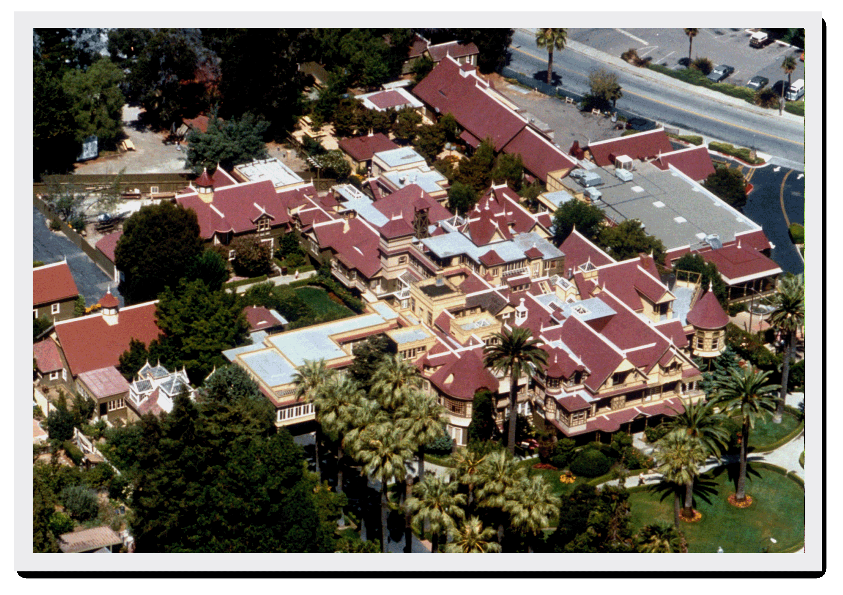
Notes:
Winchester House:
No blue print – an example of a never-ending project lacking a cohesive vision:
Number of rooms – 160
Cost - $5.5 million
Date of Construction – 1884-1922 (38 continuous years)
Number of Basements – 2
Heating – steam, forced air, fireplaces
Number of doors – 950
Number of chimneys – 19
Number of kitchens – 6
Challenge: If not working together may achieve only partial benefits/success

Slide 9

Thank you!
‘Wave Rider’ Nick.Krischanowsky@gov.bc.ca

