Slide 1
Spam Overview

Slide 2
What is Spam?
Spam is unsolicited email in the form of:
  Commercial advertising
  Phishing
  Virus-generated Spam
  Scams
    E.g. Nigerian Prince who has an inheritance he wishes to share

Slide 3
What is Bulk Email?
Bulk Email are mass email messages sent out by vendors for marketing purposes (e.g. vendor newsletters)
  Many people legitimately wish to receive bulk email from vendors and have signed up for these notifications. As such, this type of mail cannot be considered guaranteed spam.
  In many cases, users sign up for these newsletters without realizing.
  Vendors typically obtain your email address by:
    Using an email addresses provided by you at trade shows or conventions for prizes. This information is sometimes sold to other companies.
    Using an email address provided by you when signing up for an online service.
  Vendor newsletters often have an unsubscribe link at the bottom of the email message.
    It is generally not recommended to use the unsubscribe option as it validates that your email is active.

Slide 4
What is Phishing?
  Phishing is the attempt to acquire sensitive information such as usernames, passwords, and credit card details (and sometimes, indirectly, money) by masquerading as a trustworthy entity in an electronic communication.
  Source: Wikipedia (http://en.wikipedia.org/wiki/Phishing)
    One of the quickest and cheapest ways to get access to an account is to attempt to manipulate people into providing their credentials via email.

Slide 5
Phishing
What happens when an account is compromised?
  UBC user falls for phishing scam – Spammer has credentials.
  Spammer sends phishing emails to local contacts using Outlook.
  Spammer sets up rule to delete bounce-backs.
  Spammer sends traditional spam to thousands of email addresses.
Never provide your credentials to a suspicious looking website
  UBC IT will never ask for your credentials.
  If a site is asking for your credentials, do not provide them especially if the site has no UBC look-and-feel and isn’t hosted in the ubc.ca domain.
  Look for errors in spelling and grammar in the message. In many cases, the content is purposely vague so that it can be used in different environments, although spammers are getting more sophisticated.

Slide 6
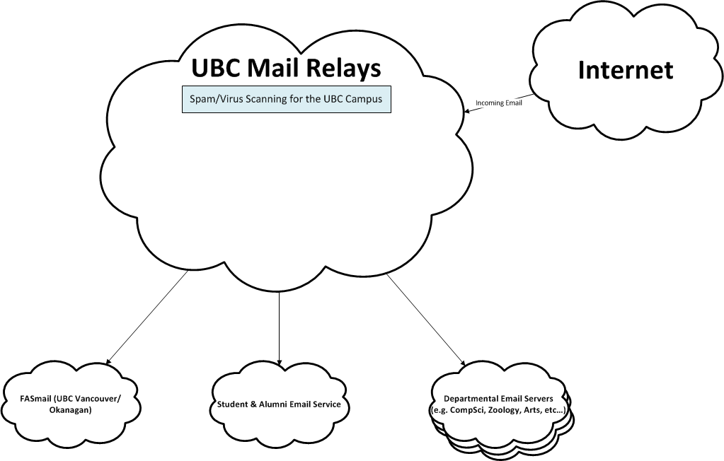
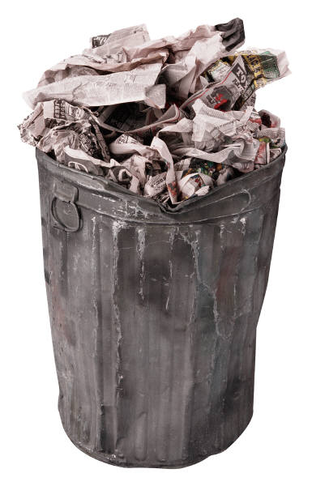




Method Two: Spam Scoring
Method One: Sophos IP Block List
SCORING
If Known Spammer
High Probability
Medium Probability
Spam?
+
SPAM?
Low Probability

Slide 7
Statistics
Incoming Mail Stats (one day in June)
Total: 819,395
Legitimate: 204,695 (25%)
Blocked based on known spammer IPs: 408,477 (50%)
Blocked high probability spam: 49,455 (6%)
Tagged medium probability spam: 68,320 (8%)
Tagged bulk email (e.g. vendor newsletters): 87,400 (11%)
Blocked messages containing virus: 1,005 (0.1%)
Other: 43 (0.005%)
Total spam identified (not including Bulk Email): 527,257 (64%)

Slide 8
Setting Expectations
“In the past two days, I received 5 to 10 spam emails.”
Clearing up misconceptions:
It is normal to receive this many vendor newsletters but not necessarily this much spam.
The amount of spam fluctuates on a daily basis. There is typically no consistency.
The longer the email address has been active, the more likely it will receive spam. For example, email forwarding from @interchange.ubc.ca addresses may cause an increase in spam.
Spammers continually evolve and find new ways to elude spam filters.
The amount of spam sent grows every year.
Spam is a fact of life. We can only reduce it, not eliminate it.

Slide 9
What can you do?
Enable Server-Side Spam Filtering
Enable Server-Side Bulk Email Filtering
Submit Spam Samples
Unsubscribe from Newsletter Emails from Legitimate Companies
Use Outlook’s Built-in Spam Engine
To find out how to take these actions, please visit the following website: http://it.ubc.ca/services/security/ubc-information-security-office/avoiding-spam

Slide 10
Spam/Phishing Sample
Hello,
I am barrister Ryan Lachlan from Australia;a lawyer/consultant to a renowned politician from Nigeria who has been currently indicted on corruption charges and whose name i can not reveal to you in this email for security and personal reasons.
My client has been accused of contract inflation while in office and he feared that if quick action is not taken the government of his country might froze his Trust Account of which i am the Trustee and for this reason i am given this responsibility to transfer this fund out of Nigeria immediately.
In the light of the above circumstances,My client have instructed me to assist him transfer the sum of $14,000.000.00 USD (Fourteen million Dollars) out of his Trust account to your country to avoid his fund being confiscated.
I am seeking your cooperationt to act as the recipient to these funds.
Acting on the advise of my client,you will be given 20 % of the total cash amount after funds have been successfully transfered to your bank.
To avoid possible squabble,please note that this proposal is subject to fluidity and as such your role, position and dividents are all negotiable.
As a lawyer I guarantee you that this will be executed under a legitimate arrangement through the administration of power of attorney that will protect you from any breach of law.
Awaiting your prompt response.
I Remain obliged.
Yours faithfully,
Barr. Ryan Lachlan
Tel: <phone_number_removed>
Australia

Slide 11
Spam/Phishing Sample
Your E-mail address have been awarded the sum of (£950,000 )Nine Hundred and fifty Thousand Great British Pounds)attached to Ticket Number UNF-03945-UNOG,you are advised to contact the E-mail below:
Finance Officer- Chuck Ash
Email: <email_address_removed>
Phone Number: <phone_number_removed> Sincerely Yours R. E. Turner,
Chairman of the Board © 2012
UN Foundation,North-Africa Cordinator Contact + <phone_number_removed>
------------------------------------------------------------------------------------------------------------------
L0ANS
This is to inform you that we offer all types of L0ans @ 3% annual rate. To
apply, DO NOT CLICK REPLY..but SIMPLY COMPOSE A NEW MESSAGE to the loan firm via
email: <email_address_removed>

Slide 12
Spam/Phishing Sample
From: <FASmail user>
Subject: Dear eMail user
This message requires that you verify your mailbox and increase its quota.
You are currently running on 23GB instead of 20GB Due To Hidden Files and Folders in Your Mailbox. You will be unable to receive new email, Loss Important Information in Your Mailbox/Or Cause Limited Access to It if not verified.
To complete this verification simply Click : <URL Removed – see next slide>
System Help Desk
@eMail ACCOUNT SUPPORT TEAM".
Reserved. Account Maintenance 2013

Slide 13
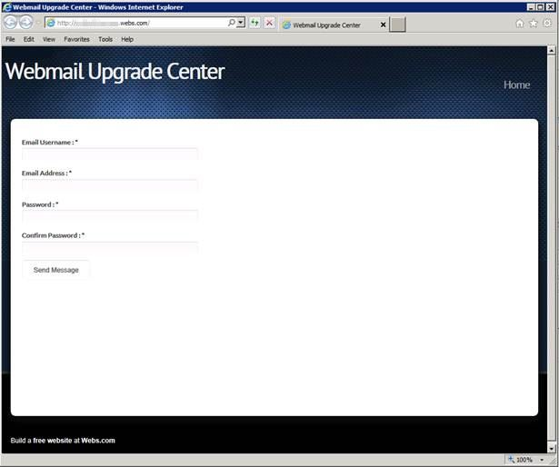

Slide 14
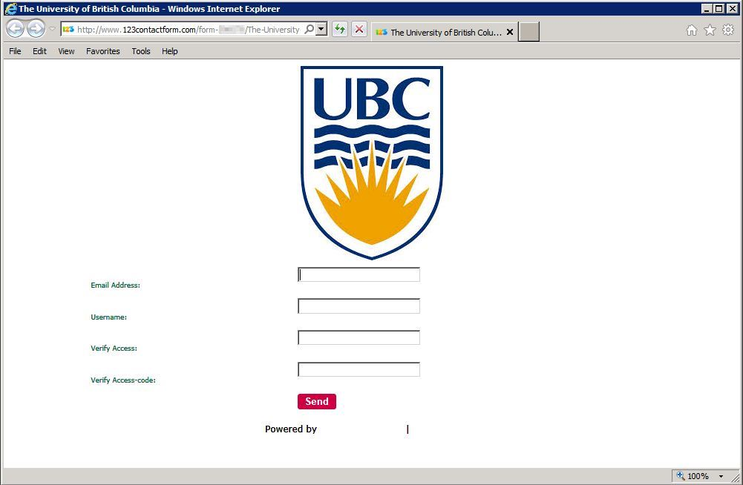
Other Phishing Sites

Slide 15
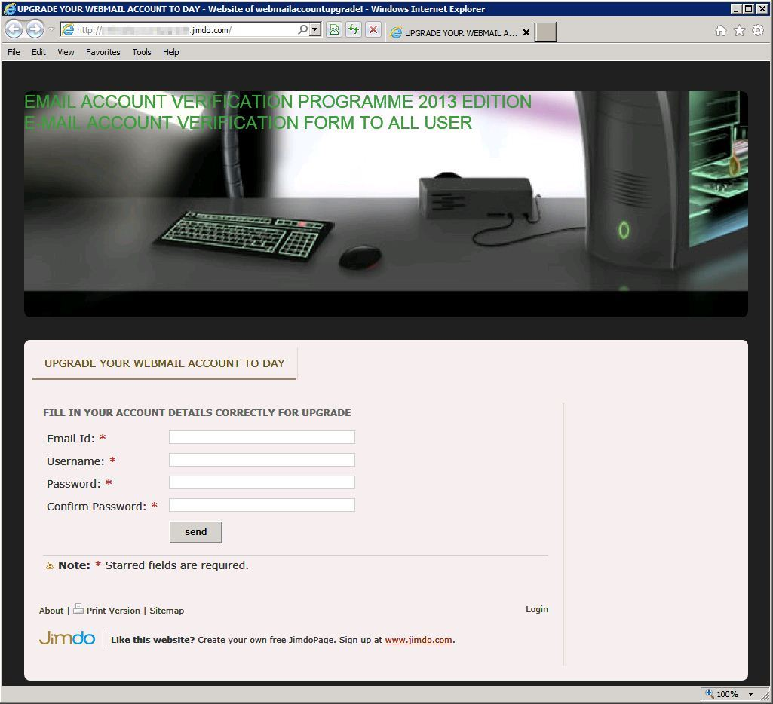
Other Phishing Sites

